Slide 1
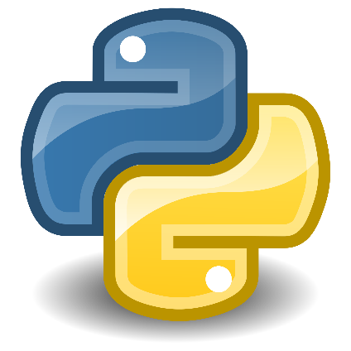


Class: IX Lab: 15
Python
Function

Slide 2


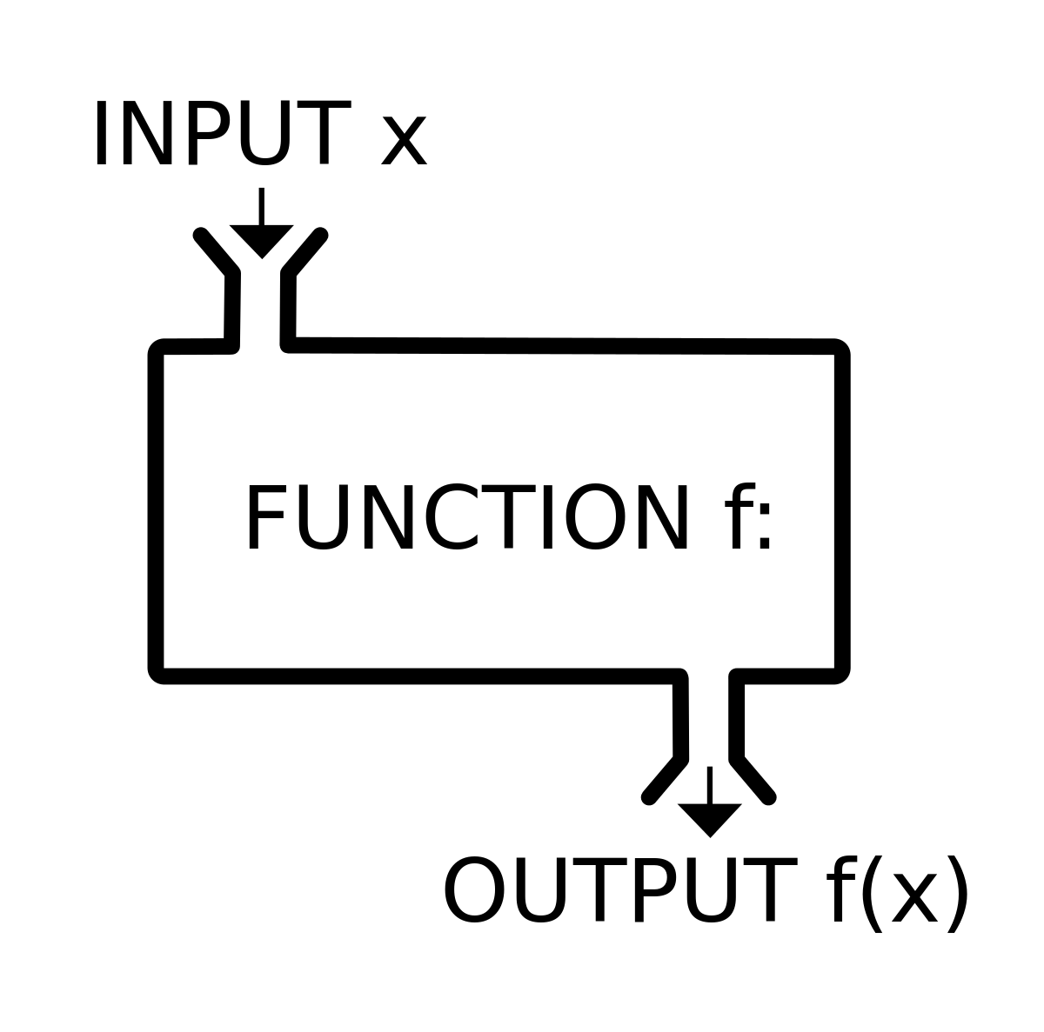
Functions
A function is a block
of code which only runs when it is called

Slide 3

Declare Function
In Python a function is defined using the def keyword

Slide 4
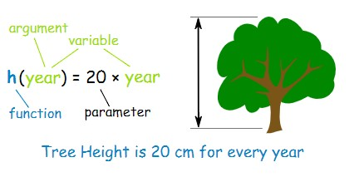
Parameter
Information can be passed to functions as parameter

Slide 5
Parameter
Information can be passed to functions as parameter

Slide 6
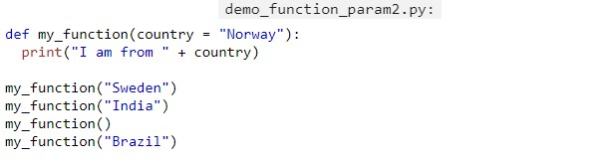
Parameter Value
If we call the function without parameter, it uses the default value:

Slide 7
Parameter Value
If we call the function without parameter, it uses the default value:

Slide 8

Lambda
A lambda function can take any number of arguments, but can only have one expression

Slide 9
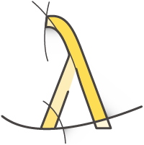
Why Lambda?
The power of lambda is better shown when you use them as an anonymous function inside another function

Slide 10
